Slide 1



FRAUD DETECTION
Anomaly detection is KING… for now

Slide 2


OBJECTIVES
1. To improve data quality
2. To improve the fraud investigation efforts
3. To create a fraud detection system given the available data and resources

Slide 3





OUTLINE
How are we doing in our fight against fraud?
We got this!
RMF FRAUD
OUR SOLUTION
FRAUD OVERVIEW
DATA QUALITY ISSUES
CONCLUSION & RECOMMENDATIONS
A sneak peek into fraud in the Asia-Pacific
Expectation vs. reality
Let’s all move forward!

Slide 4
FRAUD OVERVIEW

Slide 5

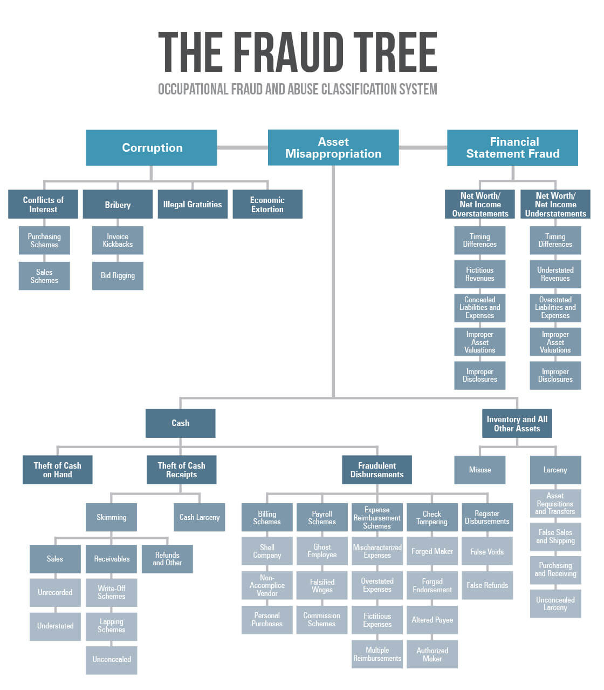
The Fraud Tree
Source: Association of Certified Fraud Examiners (ACFE)

Slide 6
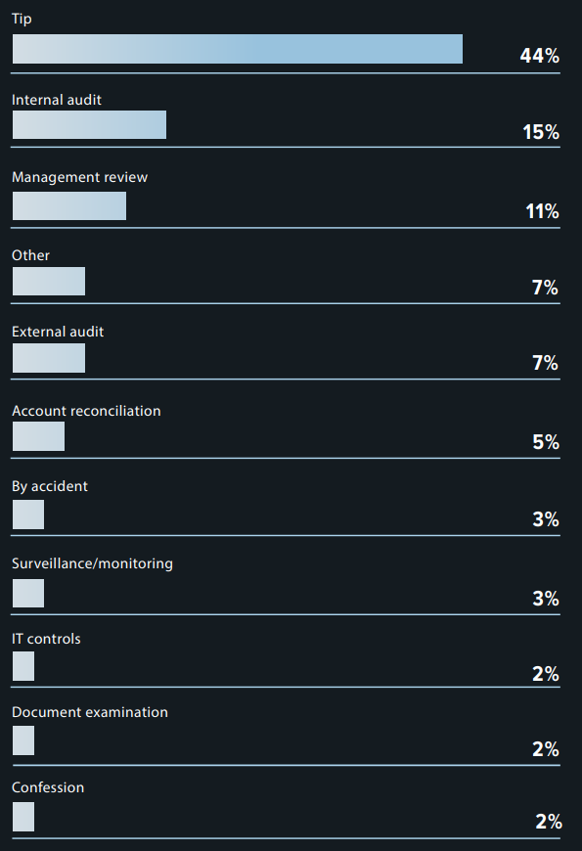
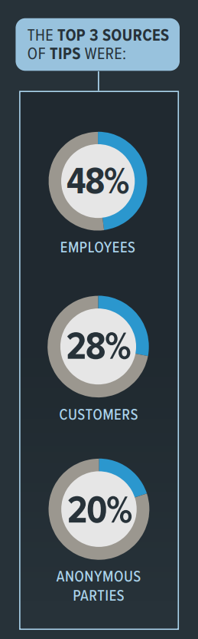
How is occupational fraud initially detected?
Only 3% of occupational fraud was detected by surveillance/monitoring
Source: ACFE Report to the Nations 2020 Asia-Pacific Edition

Slide 7
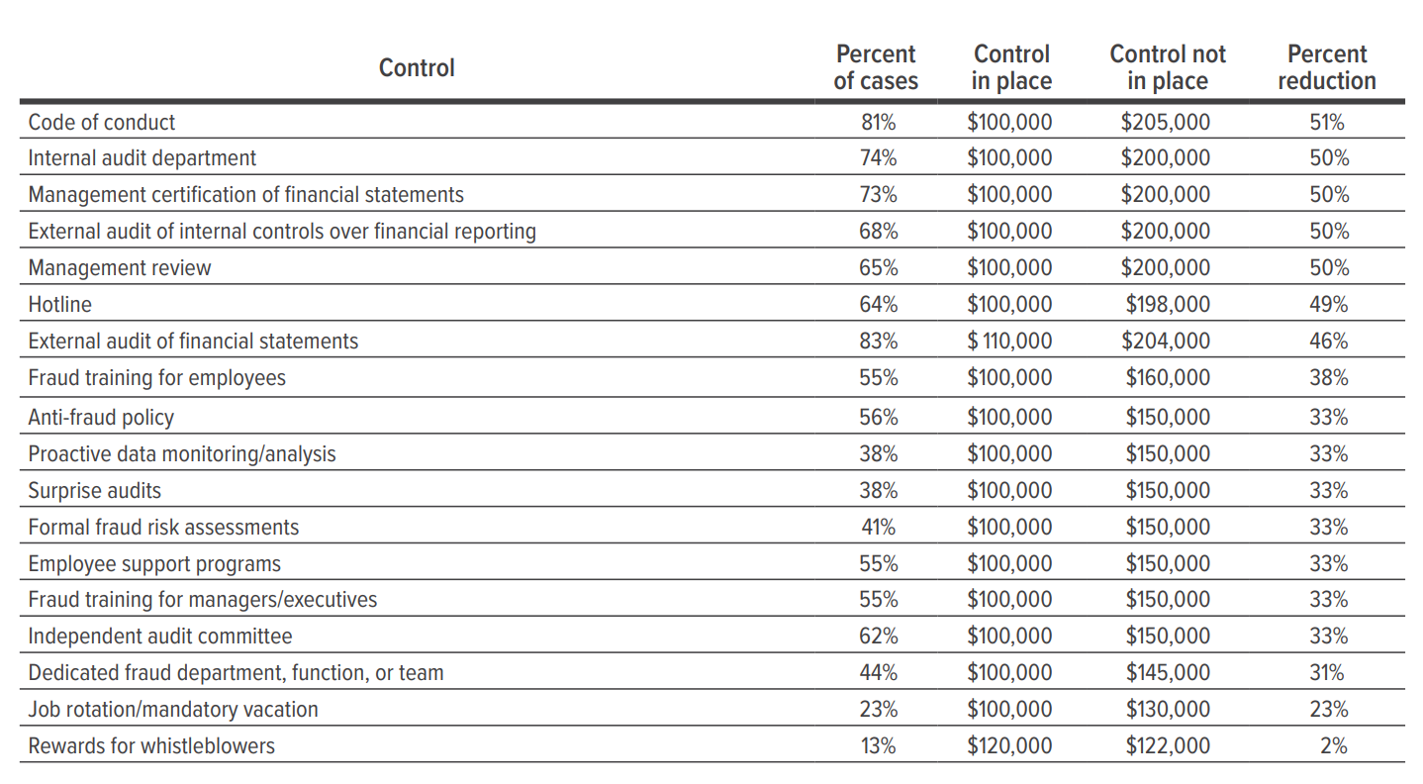
How does the presence of anti-fraud controls relate to median loss?
Source: ACFE Report to the Nations 2020

Slide 8
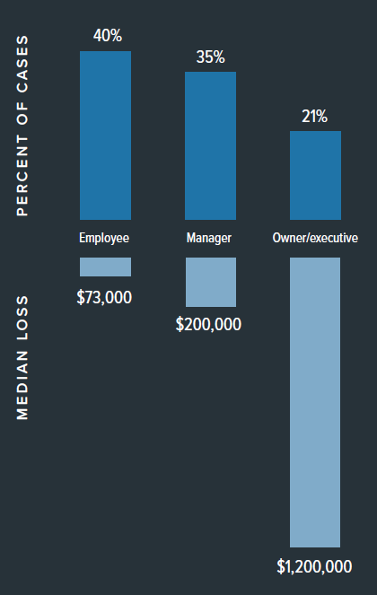
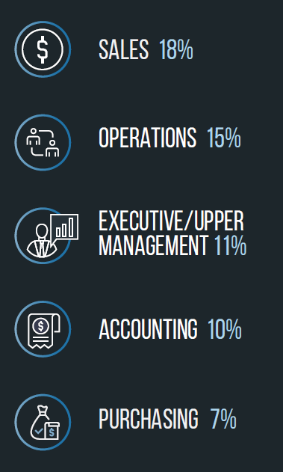
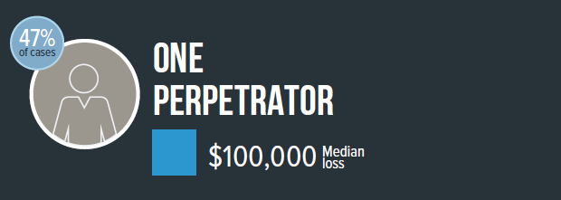
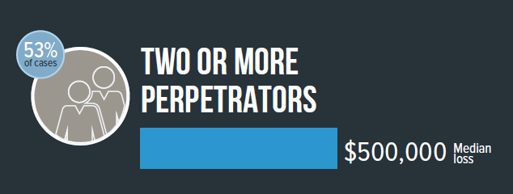
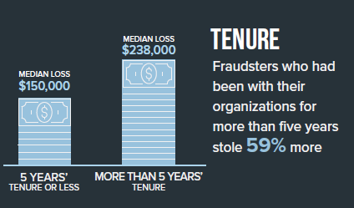
What is the usual profile of a fraud perpetrator?
Source: ACFE Report to the Nations 2020 Asia-Pacific Edition

Slide 9
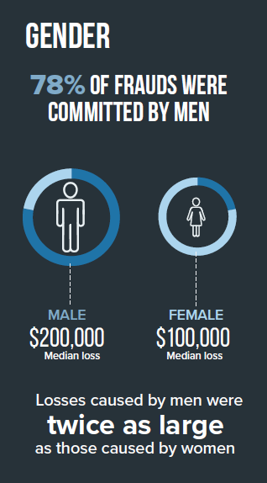
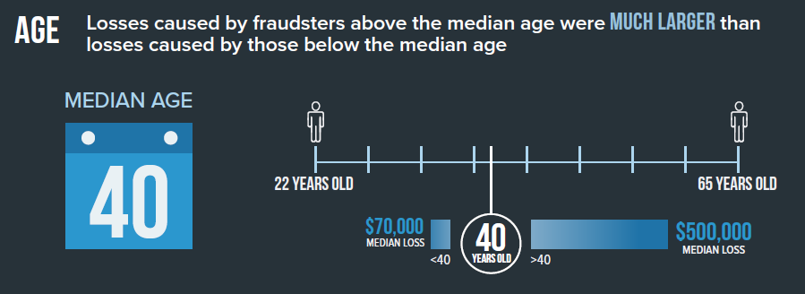
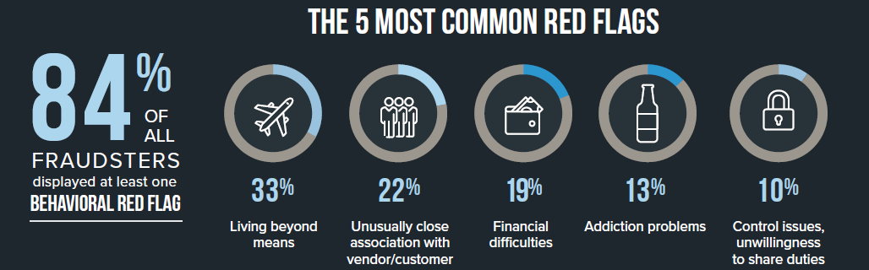
What is the usual profile of a fraud perpetrator?
Source: ACFE Report to the Nations 2020 Asia-Pacific Edition

Slide 10
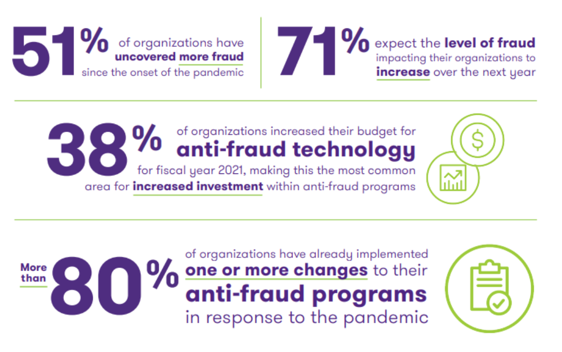
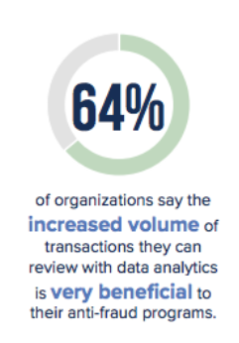
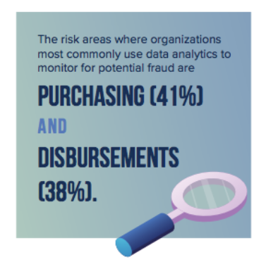
What’s the “next” normal?
Source: ACFE Fraud in the Wake of COVID-19: Benchmarking Report

Slide 11
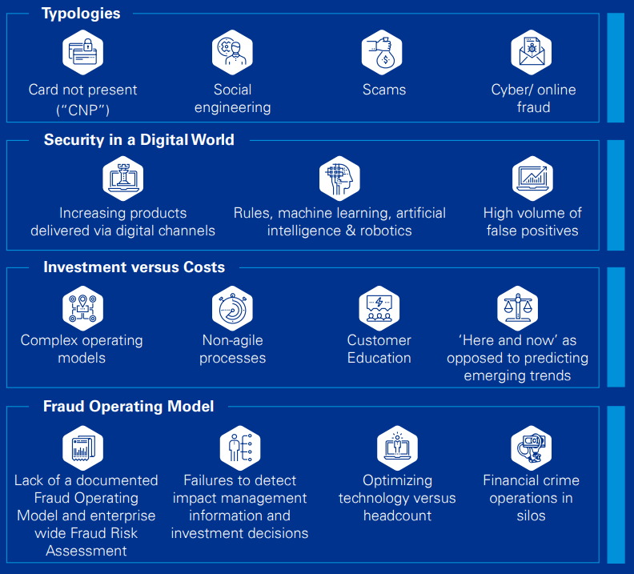
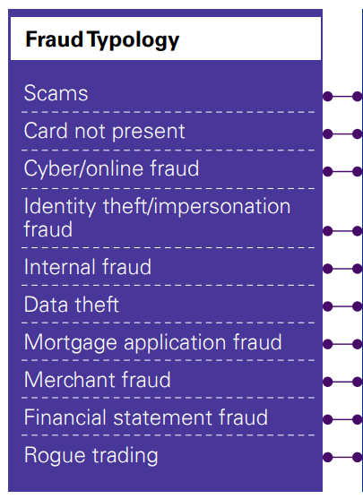
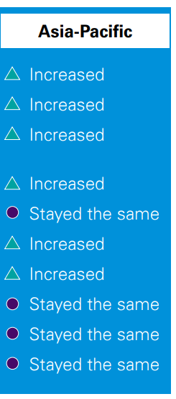
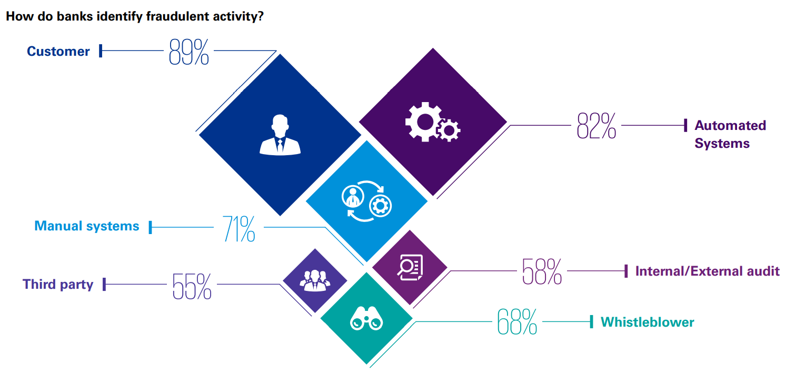
How are banks doing?
Over half of survey respondents stated fraud recoveries were less than 25% of fraud losses. This low rate demonstrates the importance of prediction and prevention efforts
Source: KPMG Global Banking Survey 2019

Slide 12
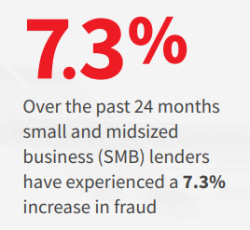
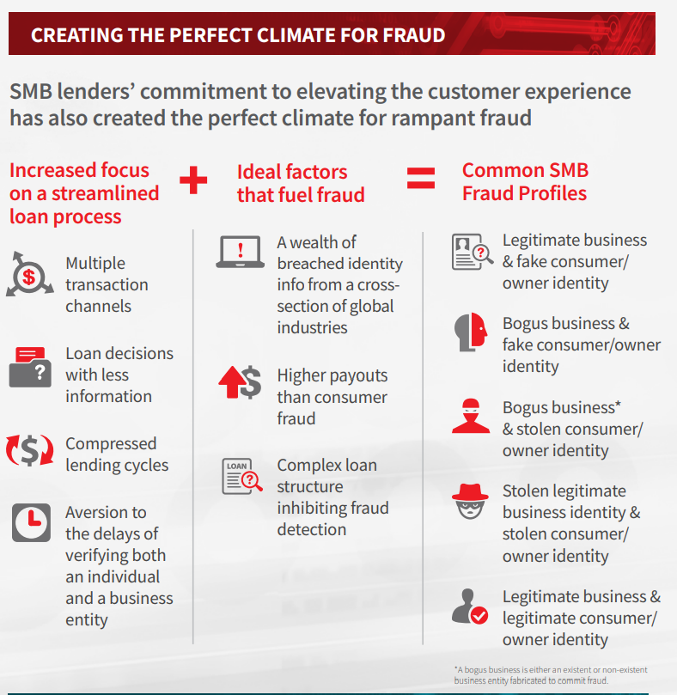
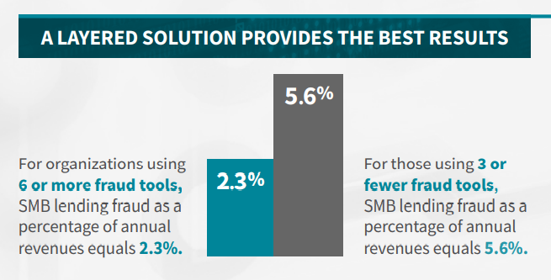
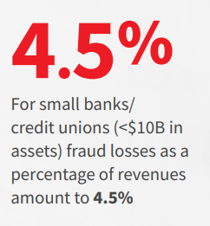
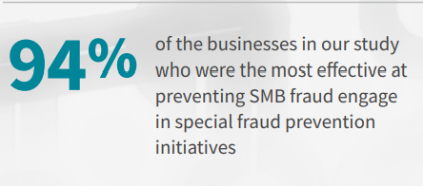
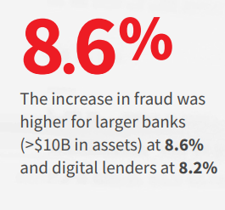
How are small and midsized business (SMB) lenders doing?
Source: LexisNexis 2019

Slide 13
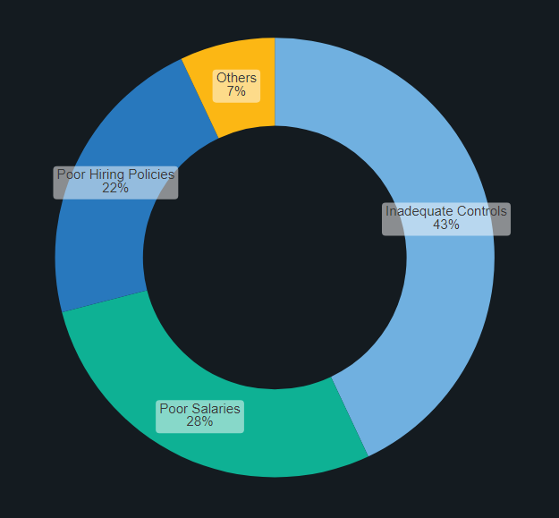

How are microfinance institutions (MFIs) doing?
Inadequate internal controls are seen to be the major cause/reason for fraud
During the Indian micro-finance crisis, line managers had disregarded even the most basic controls, i.e. segregation of duties
The proliferation of agents and the shortest lead time to disburse loans as an incentive criterion resulted from efficiency drive which resulted in the omission of key controls in many MFIs.
An unusual finding from the study stated that Internal Auditors are perceived to be major fraud perpetrators
Source: Internal Controls, and the Incidence of Fraud in Microfinance Institutions in the Southwest Region of Cameroon (Sama, 2016)

Slide 14
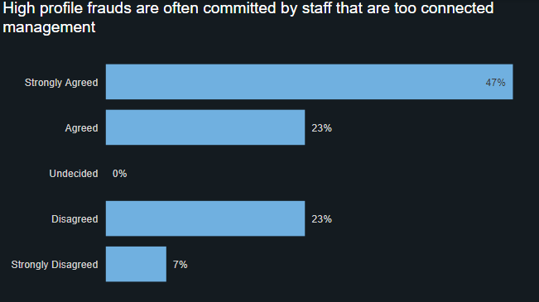
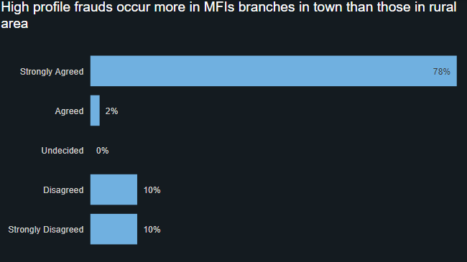
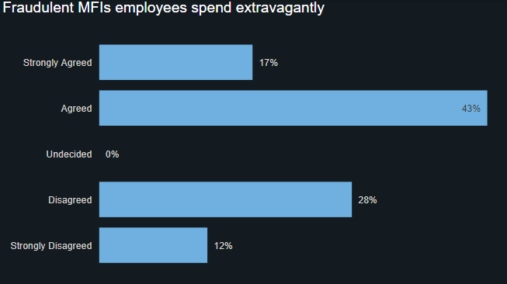
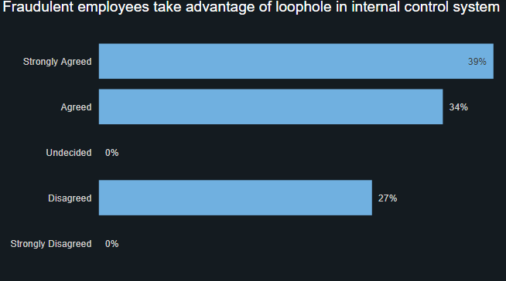
How are microfinance institutions (MFIs) doing?
Source: Towards Effective Fraud Risk Management in Micro Finance Banking in Nigeria (Chukwunedu & Okafor, 2013)

Slide 15
RMF FRAUD DATA

Slide 16
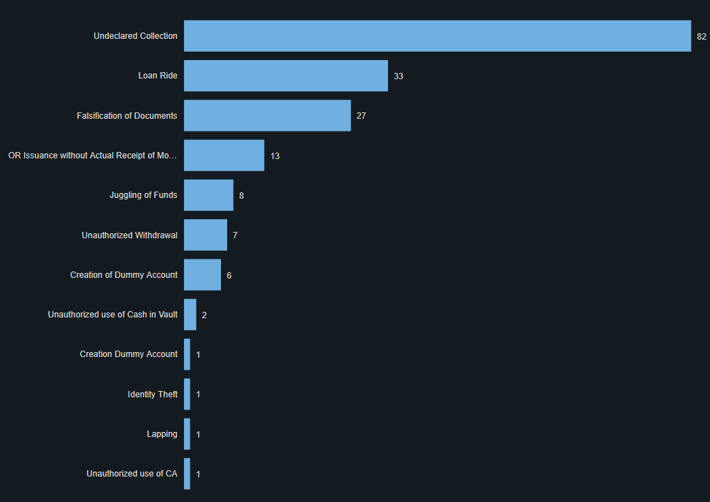
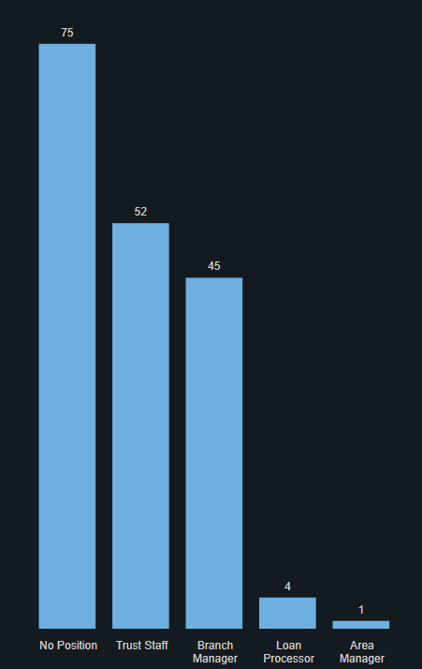
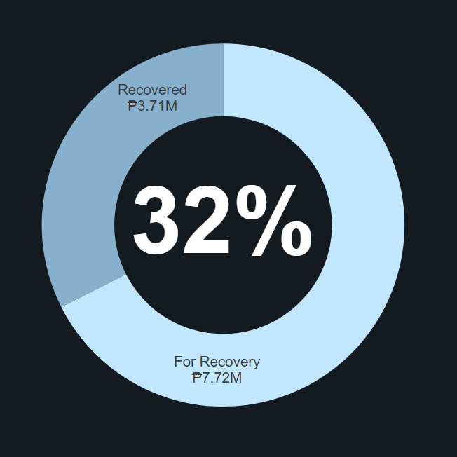
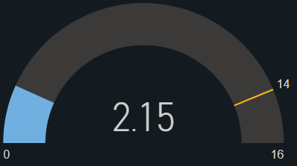
How are we doing?
Fraudsters were mostly Trust Staffs and Branch Managers
There are a total of 195* fraud cases to date
Only 32%* of losses from fraud were recovered
Fraud was detected at an average of 2-3 mos., better than 14 mos. based on ACFE
*data is from Aug 2018 to Oct 2021
Source: Fraud Detection, FTW 2020

Slide 17
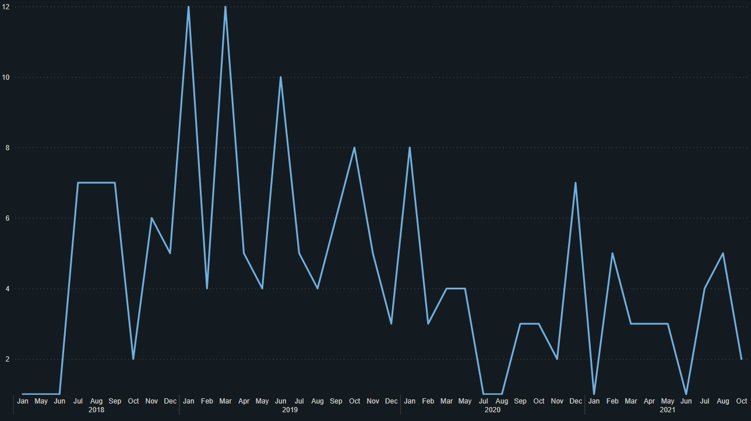
How are we doing?
P770,721 vs P49,909,538
amount involved in fraud detected in 2021
estimated fraud loss based on ACFE (5% of P998,190,756* revenue)
2%
*Source: RAFI Micro-Finance 2020 Annual Report

Slide 18
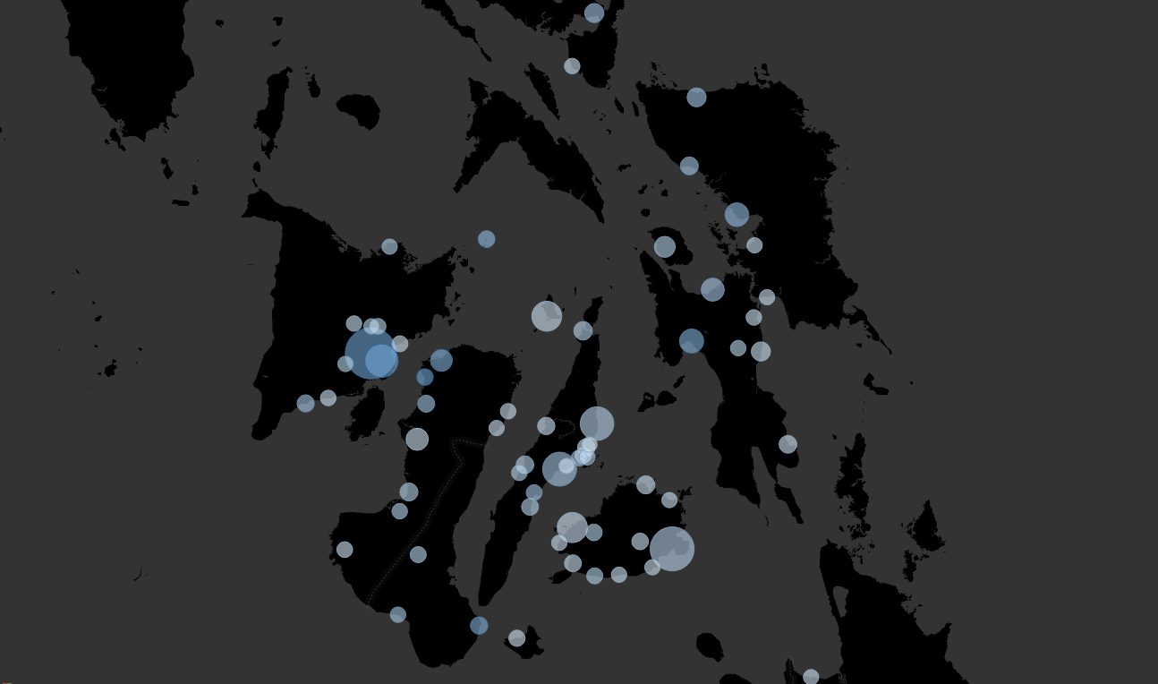
How are we doing?
Ormoc City (P335K and Catbalogan City (P320K) in Eastern Visayas
Guindulman (P1.1M), Minglanilla (P699K), and Danao (P688K) in Central Visayas
Pototan (P1.4M) and Barotac Nuevo (P680K) in Western Visayas
*data is from Aug 2018 to Oct 2021

Slide 19
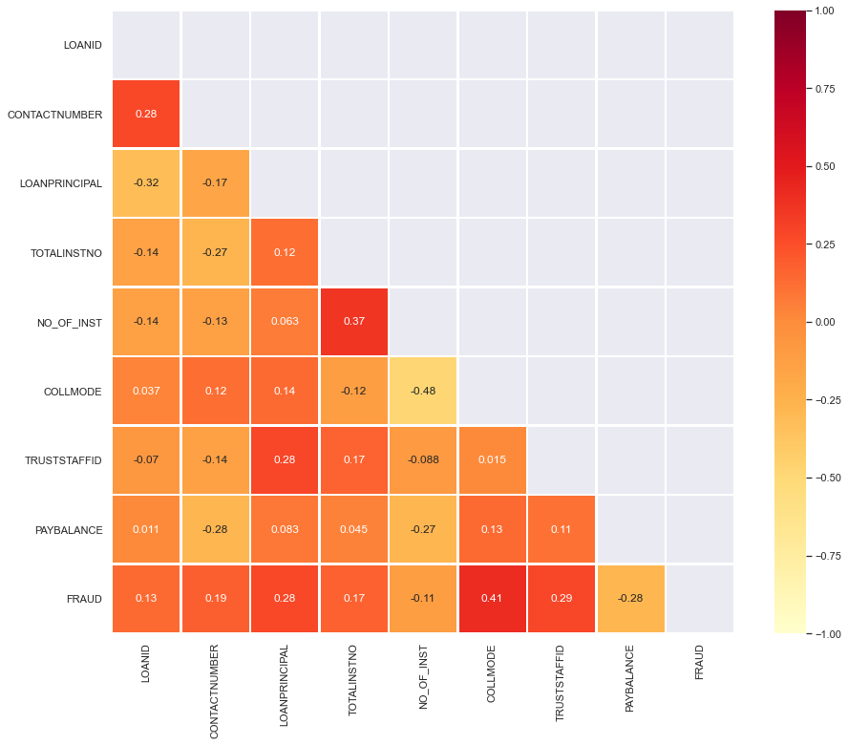
How are we doing?
“Fraud is relatively more correlated with internal factors such as collection mode (payment method in Instafin) and trust staff involved”
-FTW, 2020
Source: Fraud Detection, FTW 2020 (fraud cases as of September 2020)

Slide 20
RMF SYSTEM DATA

Slide 21





What are our limitations and challenges?
Lack of metadata/ERD; 1M row limitation in Instafin; slow report generation and time-outs
Large dataset; absence of a data warehouse/cloud storage to deploy model
DATA ACQUISITION
MODEL TRAINING AND DEPLOYMENT
LIMITED FRAUD DATASET
DATA QUALITY
Fraud cases monitoring is insufficient to trace fraud cases in Instafin
Lack of application controls and system configurations; human error

Slide 22

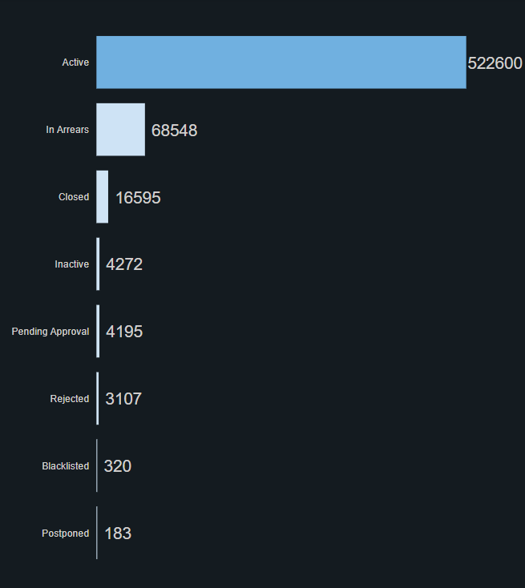
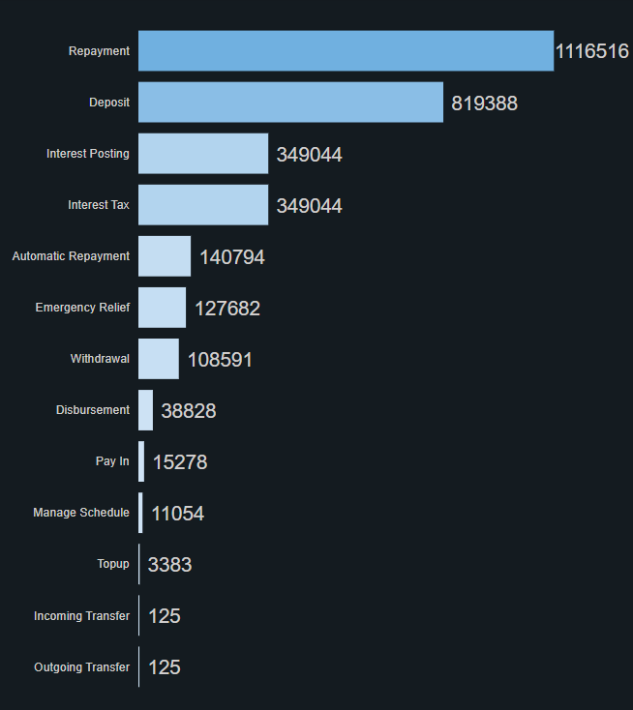
619,820
Let’s look at our data…
3,079,852
clients
transactions for January 2022

Slide 23
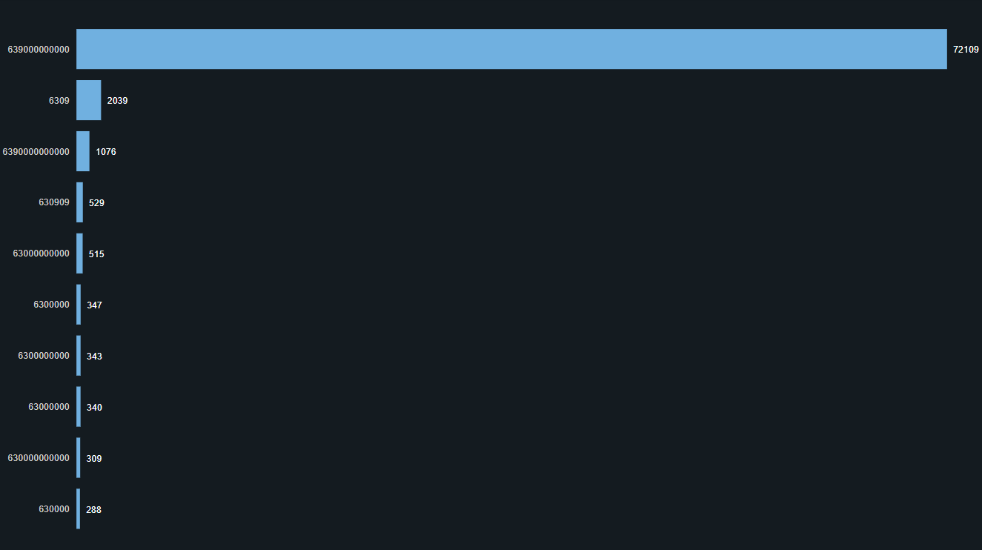
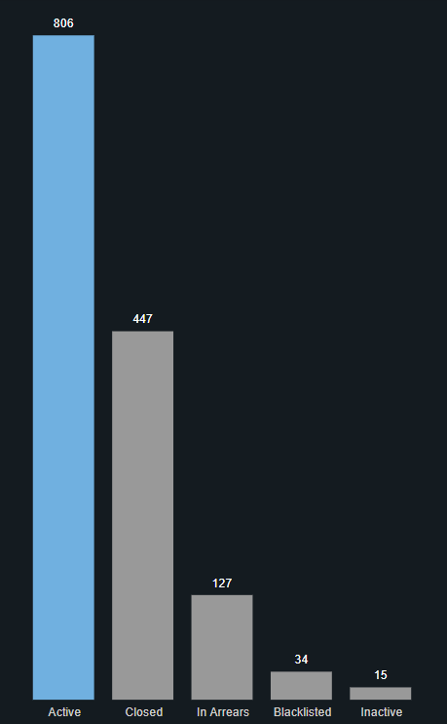
Let’s look at our data…
Are these really our clients’ phone numbers? How do we contact them?
Instafin allows duplicate entries of phone numbers and accepts phone numbers with less than 11 digits
806 active clients have no phone numbers

Slide 24
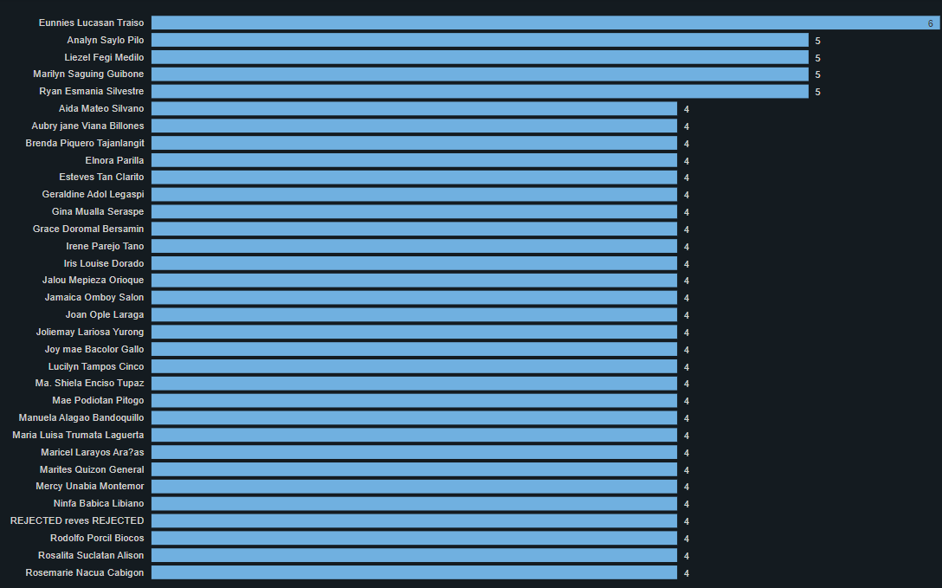
Let’s look at our data…
Why are we creating multiple accounts for our clients?
7,569 clients have the same name and branch resulting in 15,426 unique client IDs (2,584 active, 5,187 client IDs)
604 active clients have the same name, branch, and phone number (1,210 client IDs)
Instafin allows entries of clients with existing records (the same name and in the same branch)
*clients with more than 3 similar names

Slide 25
Let’s look at our data…
Let’s look at an example of a client duplication…
The client is currently active but with two accounts (represented by two unique client ID).
It is a duplicate based on the identical names, phone numbers, and branches, and the period between the creation of the two accounts.

Slide 26
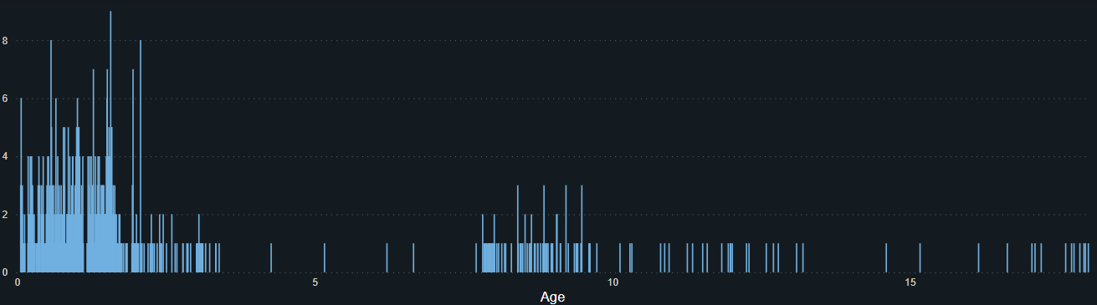
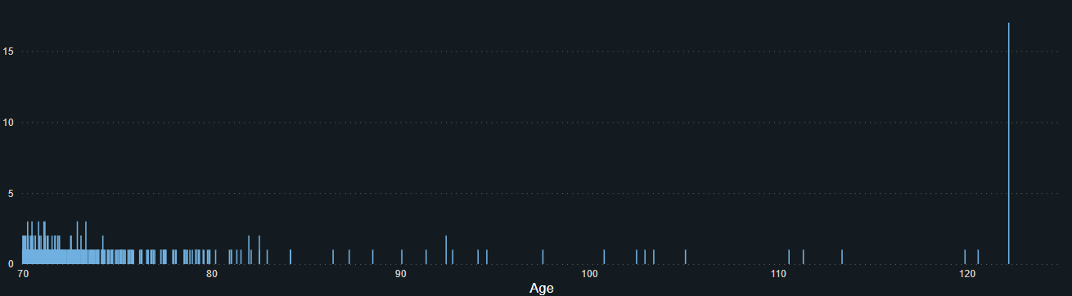
Let’s look at our data…
Do we really have very young and old clients?
868 clients are below 18 years old (430 active)
480 clients are above 70 years old (17 active clients have birthdays on 01/01/1900)
Instafin allows entries of clients that are below 18 years old
*current age
Notes:
The date of birth of some clients are the same with the date they were created in the system.

Slide 27
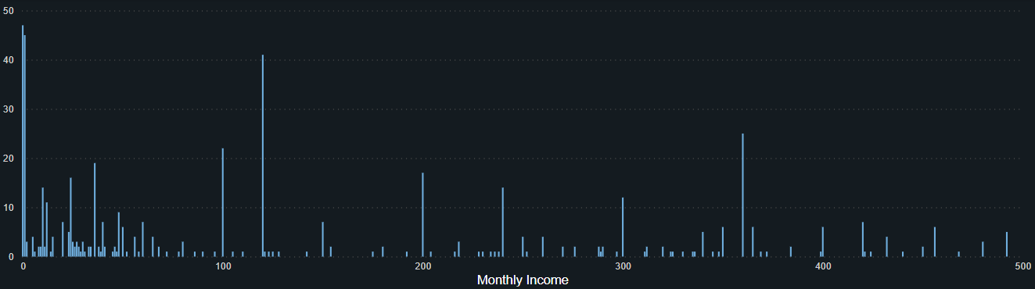
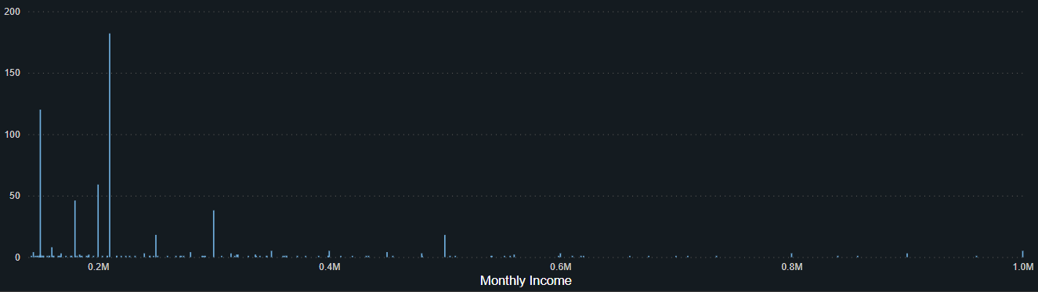
Let’s look at our data…
Some of our clients seem very rich… others have no income
511 clients have monthly income < P500 (47 with P0 monthly income)
2,131 clients have no data on monthly income
687 clients are in the upper income group (monthly income > P140,284)*
220 clients are rich (monthly income > P233,807)*
*Income Group from CNN Philippines 2020

Slide 28
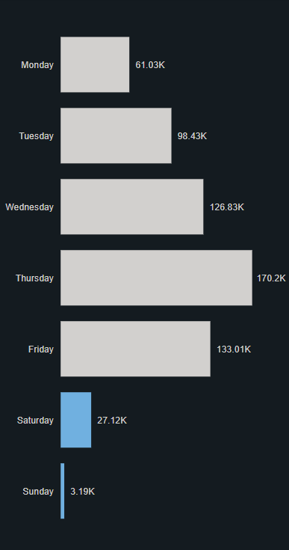
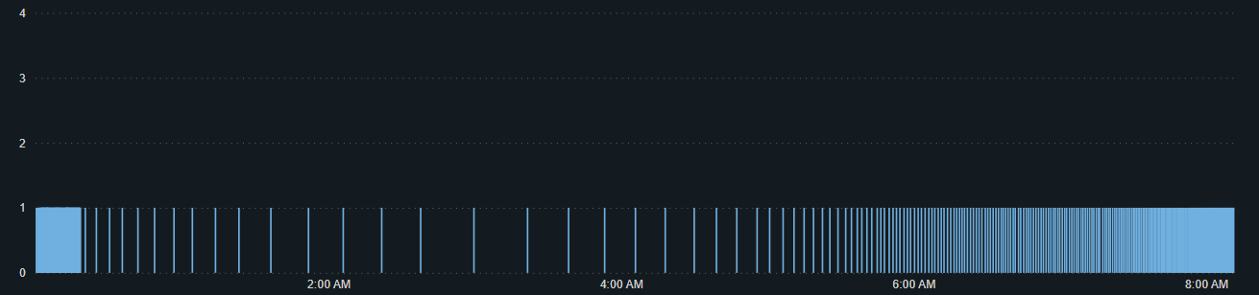
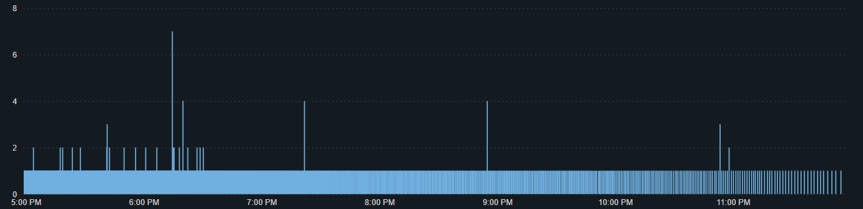
Let’s look at our data…
Some clients were created during weekends and at very odd times...
*excluded clients created at 12:00:00 AM
*time charts showing only representative sample

Slide 29
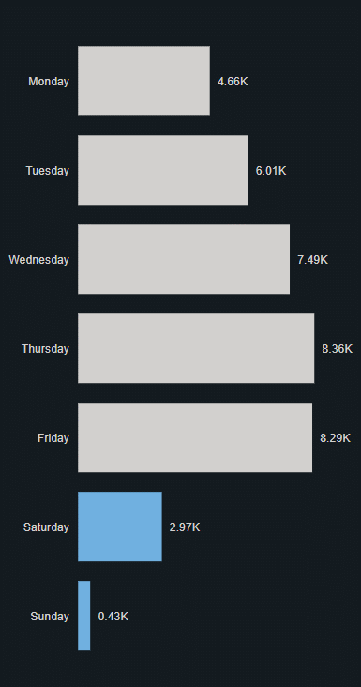


Let’s look at our data…
(Last 3 months) We are still creating clients during weekends and at non-working hours...
*excluded clients created at 12:00:00 AM
*time charts showing only representative sample

Slide 30

Let’s look at our data…
Client creations at 12:00:00 AM?
337,153 clients were created at 12:00:00 AM
Client creations were made in as early as 1951.

Slide 31

Let’s look at our data…
(Last 3 months) There are still client creations at 12:00:00 AM…
412 clients were created at 12:00:00 AM for the last 3 months

Slide 32



Let’s look at our data…
Do we approve clients during weekends and non-working hours?
*excluded clients created at 12:00:00 AM
*time charts showing only representative sample

Slide 33



Let’s look at our data…
(Last 3 months) We still approve clients during weekends and non-working hours…
*time charts showing only representative sample

Slide 34

Let’s look at our data…
Client approvals at 12:00:00 AM?
331,126 clients were approved at 12:00:00 AM
13,006 clients were approved on 1/2/2000

Slide 35


Let’s look at our data…
A lot of typos and incosistencies in cities
Instafin allows null values under the city field and lacks a drop-down list to prevent typos and promote consistency in city names

Slide 36


Let’s look at our data…
More inconsistencies in provinces…
Instafin allows null values under the state (province field) and lacks a drop-down list to prevent typos and promote consistency in state (province) names

Slide 37

Let’s look at our data…
Philippines?

Slide 38



Let’s look at our data…
(Pre-Odette)* Do we normally enter transactions outside working hours/days?
1,324,263 or 23% of transactions were made outside working hours
*October to November 2021

Slide 39



Let’s look at our data…
(Post-Odette)* Do we normally enter transactions outside working hours/days?
1,163,276 transactions were made outside working hours, 60% are interest-related
466,190 or 20% transactions were made outside working hours (exc. interest-related)
*January 2022

Slide 40


Let’s look at our data…
(Pre-Odette)* Why do we have walk-in transactions outside working hours/days?
123,843 walk-in transactions were made outside working hours
*October to November 2021

Slide 41


Let’s look at our data…
(Post-Odette)* Why do we have walk-in transactions outside working hours/days?
31,560 walk-in transactions were made outside working hours
*January 2022

Slide 42

Let’s look at our data…
(Pre-Odette)* Backdating
90 transactions were backdated more than 6 days (max of 31 days or around 1 month)
*October to November 2021

Slide 43

Let’s look at our data…
(Post-Odette)* Backdating
228 transactions were backdated more than 6 days (max of 82 days or around 3 months)
*January 2022

Slide 44
Actions needed…
Variable/Feature | Applicable Model | Instafin Recommendations | Correction/s Needed | Urgency
Phone Number | Client Enrolment | Character length requirement | Prospective corrections as these are clients’ personal information | Medium
Birthday | Client Enrolment | Min and Max Values | No immediate action required as anomaly detection models for Client Enrolment and Loan Application will be made next year
Monthly Income | Client Enrolment, Loan Application | Min and Max Values | No immediate action required as anomaly detection models for Client Enrolment and Loan Application will be made next year
City | Client Enrolment | Drop-down List
State (Province) | Client Enrolment | Drow-down List
Country | None | Fixed Value | Retrospective correction | Low
Client Created Date | Client Enrolment | None | None | N/A
Client Approved Date | Client Enrolment | None | None | N/A
Entry Time | Transactions | None | None | N/A

Slide 45
How do we handle these data quality issues?
Issue | Solution
Missing Values | PyCaret’s Missing Values Imputation: Numeric Imputation = ‘mean’ Categorical Imputation = ‘constant’
Typographical Errors | Pycaret: Handle Unknown Levels: unknown categorical levels in new / unseen data are replaced by the most or least frequent level as learned in the training data Combine Rare Levels: all levels in categorical features below the threshold are combined together as a single level

Slide 46
In conclusion…
There are still errors in Instafin which were not prevented due to the lack of application controls.
Trust Staffs are still creating clients outside working hours and days
Branch Managers are still approving clients outside working hours and days
Trusts Staffs are still recording transactions outside working hours and days
There are still walk-in transactions outside working hours and days

Slide 47
RMF FRAUD DETECTION

Slide 48

Fraud Detection Techniques
Source: Ahmed et al., 2021

Slide 49



Why did we use Machine Learning?
Supervised
Unsupervised
Sources: Fraud.net, itransition, SDK.finance, Maruti Techlabs

Slide 50
Why did we select Anomaly Detection?
Anomaly Detection | Supervised Learning
Very small number of positive examples (y=1). (0-20 is common). Large number of negative (y=0) examples. Many different “types” of anomalies. Hard for any algorithm to learn from positive exxamples what the anomalies look like; future anomalies may look like nothing like any of the anomalous examples we’ve seen so far | Large number of positive and negative examples Enough positive examples for algorithm to get a sense of what positive examples are like, future positive examples likely to be similar to ones in training set.
Fraud detection Manufacturing (e.g. aircraft engines) Monitoring machines in a data center | Email spam classification Weather prediction (sunny/rainy/etc.) Cancer classification
Source: Andrew Ng, Stanford University

Slide 51

Why did we choose Isolation Forest (iForest)?
Best-in-class performance that generalizes.
Receiver Operating Characteristic (ROC) Performance. iForest leads across most datasets and in aggregate, as shown by mean, median and standard deviation colors.
Source: Yue Zhao, PYOD

Slide 52

Why did we choose Isolation Forest (iForest)?
Best-in-class performance that generalizes.
Execution Time. iForest is the fastest performing algorithm for its performance. PCA and Histogram-based Outlier Score (HBOS) are expectedly faster across all datasets.
Source: Yue Zhao, PYOD

Slide 53
What does literature recommend?
Author/s | Year | Best Algorithm | Other Algorithms Compared
Dwivedi et al. | 2021 | Isolation Forest | Random Forest, Decision Tree, Logistic Regression, Local Outlier Factor (LOF)
Madkaikar et al. | 2021 | Gradient Boosting | Support Vector Machine (SVM), KNN, Logistic Regression, Naïve Bayes, Random Forest, Error Back Propagation Algorithm (EBPA)
Negi & Arjun | 2021 | Isolation Forest | LOF
Meenu et al. | 2020 | Isolation Forest | None
Waspada et al. | 2020 | Isolation Forest | None
Vijayakumar et al. | 2020 | Isolation Forest | LOF
Gao et al. | 2019 | Isolation Forest | One Class SVM, LOF
Shakya | 2018 | Random Forest | Logistic Regression, XGBoost
Ounacer et al. | 2018 | Isolation Forest | OCSVM, K-means
Liu et al. | 2008 | Isolation Forest | ORCA, LOF, Random Forest

Slide 54



What is iForest?
The core idea is that it should be very easy to “isolate” anomalies based on the characteristics that make them unique. If we fit a decision tree on all the observations, outliers should be found closer to the root of the tree than “normal” instances.
Each isolation tree is created using the following steps:
Randomly sample N instances from the training dataset.
At each node:
Randomly choose a feature to split upon
Randomly choose a split value from a uniform distribution spanning from the minimum value to the maximum value of the feature chosen in Step 2.
Steps 2 and 3 are repeated recursively until, in principle, all N instances from your sample are “isolated” in leaf nodes of your isolation tree—one training instance per leaf node.

Slide 55


How will we do it?
Data Processing
Modelling
Deployment
Retrieve Data
Clean and Explore
Prepare/ Transform
Develop and Train Model
Monitor & Update Model & Data
Stratified Random Sampling
Isolation Forest
One Hot Encoding
Withdrawal
Validate/ Evaluate Model
Deploy to Production
Repayment
Factor Analysis of Mixed Data (FAMD)
Power BI
Deposit
Variable/ Feature Selection
Normalization
z-score
Client Enrollment
To be deployed in Q2 2022 year when sufficient data can be generated/pulled from Instafin
Loan Application
Transformation
yeo-johnson
3-4 hours per week of data
1 hour
1 hour
30 mins
1-2 hours
3-4 hours per transaction type
Weekly
Weekly
Weekly
Monthly
Monthly
Weekly

Slide 56


Slide 57


Slide 58


Slide 59
INSIGHTS & RECOMMENDATION

Slide 60
Objective 1: To improve data quality
INSIGHTS
There are data quality issues among the following:
Phone numbers
Presence of duplicates
Presence of null values (even for active clients)
Absence of required character length (11 digits)
Duplicated clients resulting from lack of input controls and system configuration
Client age ranges from 0 to 122 years old due to lack of minimum and maximum value requirements for date of birth
Client monthly income ranges from P0 to P213,456,789,098,765,440
Typos and inconsistencies in client address due to lack of drop-down list
RECOMMENDATIONS
DATA QUALITY IMPROVEMENT
The BI Team will send the list of dataset with quality issues for manual correction/updating in Instafin prospectively, to be performed by data custodians or IT data steward/admin
RMF Operations Leaders should take accountability in ensuring that data corrections are executed
ENABLE APPLICATION CONTROL
Implement input controls Instafin, e.g. character length requirements and drop-down lists

Slide 61
Objective 2: To improve fraud investigations effort
INSIGHTS
The fraud incidents trackers are not sufficient
Fraud cases monitoring lacks crucial information as Client ID, Loan ID, and transaction ID
The tracker’s data are not synced with Instafin –cannot trace the specific transaction
Template is inconsistent
The current fraud detection is limited to tip (incident reporting) and internal audit
No advanced analytics and machine learning enabled model for detection
RECOMMENDATIONS
FRAUD MONITORING IMPROVEMENT
Improve the template and add Client ID, Transaction ID, and Loan ID for better tracing in Instafin
Centralize the monitoring to sharepoint versus local onedrive
MACHINE LEARNING DETECTION MODEL
Make use of the machine learning model for fraud detection
The model provides list of transactions with fraud tags and their anomaly score as basis for fraud investigations, the dashboard also has a search function
The list of possible fraud provided by the ML model should trigger succeeding investigation to validate the fraud occurrence and implement mitigating measures, if necessary

Slide 62
Objective 3: To create a fraud detection model
INSIGHTS
The fraud dataset is imbalanced --very small number of positive examples and large number of negative examples
Model is limited to the use of unsupervised machine learning –no confusion matrix for accuracy, precision, and recall
With the huge amount of data, it is effortsome to maintain the model and update more frequently –lack of API for easy extraction and model training
There are still employees who enter and approve transactions outside working hours and days
There are walk-in transactions made outside working hours and days
Backdating is still practiced with some being done even for transactions beyond a week
Only 32% of fraud loss was recovered
Fraud was detected for an average of 2-3 months (better than the regular ACFE’s 14 months)
Fraudsters were mostly Trust Staffs
RECOMMENDATIONS
CONTINUOUS ITERATION OF THE MODEL
Trust and try the model in production to allow the ML to learn further characteristics
Update the model monthly
DATA WAREHOUSE
Correct the system data
Enable the use of API to make model refresh and updating efficient
Pull data from Instafin to AzureSQL and/or replicate Instafin’s database
CREATE FRAUD-RESISTANT ENVIRONMENT
Define acceptable and unacceptable activities
Limit the transactions that are prone to fraud –i.e. transacting outside working hours, backdating, etc.
Fully investigate anomaly or suspected fraud
Immediately investigate the possible fraud to improve detection from 2-3 months to 1 month
Treat offenders in a consistent manner.

Slide 63
Fraud Monitoring
Instafin Application Controls
01
02
Data Warehouse
Data Quality Imrovement
03
04
SUMMARY
Improve the template and add Client ID, Transaction ID, and Loan ID for better tracing in Instafin
Implement input controls Instafin, e.g. character length requirements and drop-down lists
Fraud Investigations
Pull data from Instafin to AzureSQL and/or replicate Instafin’s database
Our team will send the list of dataset with quality issues for manual correction/updating in Instafin
05
Our team will send a copy of the transactions with fraud tags and their anomaly score as basis for fraud investigations, the dashboard also has a search function

Slide 64
THANK YOU!!!
BEBIBoys at your service… ^^/

